Slide 1
The Discrete Fourier Transform
Lab session 3

Slide 2
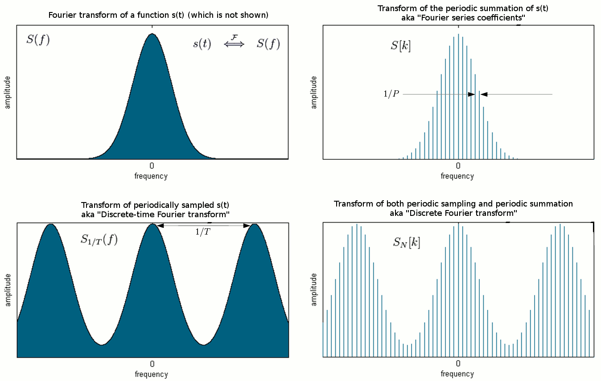
DTFT vs. DFT
DTFT: continuous F.T. for Discrete signals→ periodic ~ [0, 1] i.e. [0 , Fs] (Hz)
DFT: Discrete F.T. for Discrete signals→ periodic ~ [0, P-1] i.e. [0, Fs/P, 2Fs/P, 3Fs/P ,…, Fs] (Hz)
Time domain
Frequency domain
s(t)
P
t
t
sd(t)
N=P/Fs
T= 1/fs

Slide 3
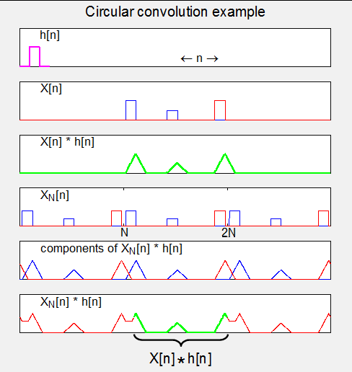
DFT and circular convolution
Multiplication in DFT domain → circular convolution in discrete time
iDFT{ DFT(x[n])x DFT(h[n]) } = x[n]*h[n]
Convolution→
Circular
Convolution→

Slide 4
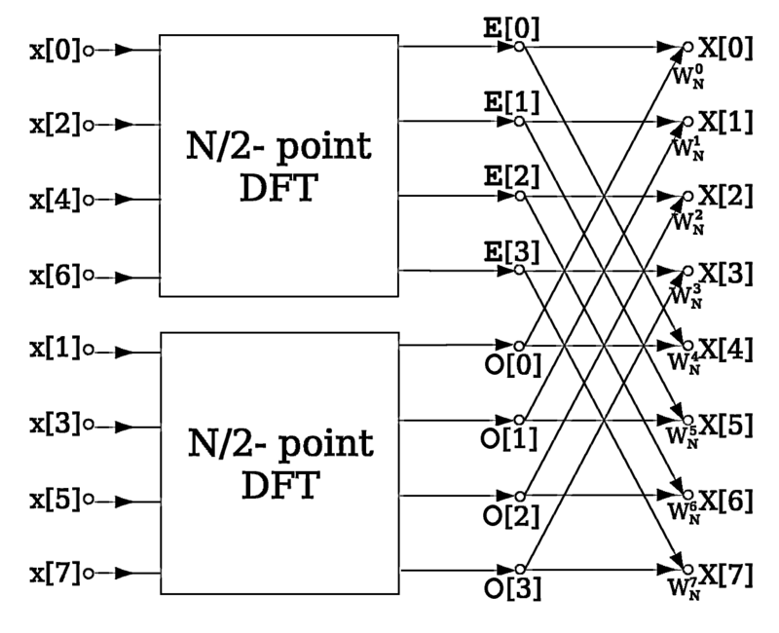
FFT fast version of DFT
FFT accelerates computation of DFT by using a Butterfly architecture
For a N-dimensional signal:
DFT complexity ~N²
FFT complexity ~ N log2(N)

